Slide 1
Chapter 17

Slide 2
Objectives

Slide 3
Objectives (continued)

Slide 4
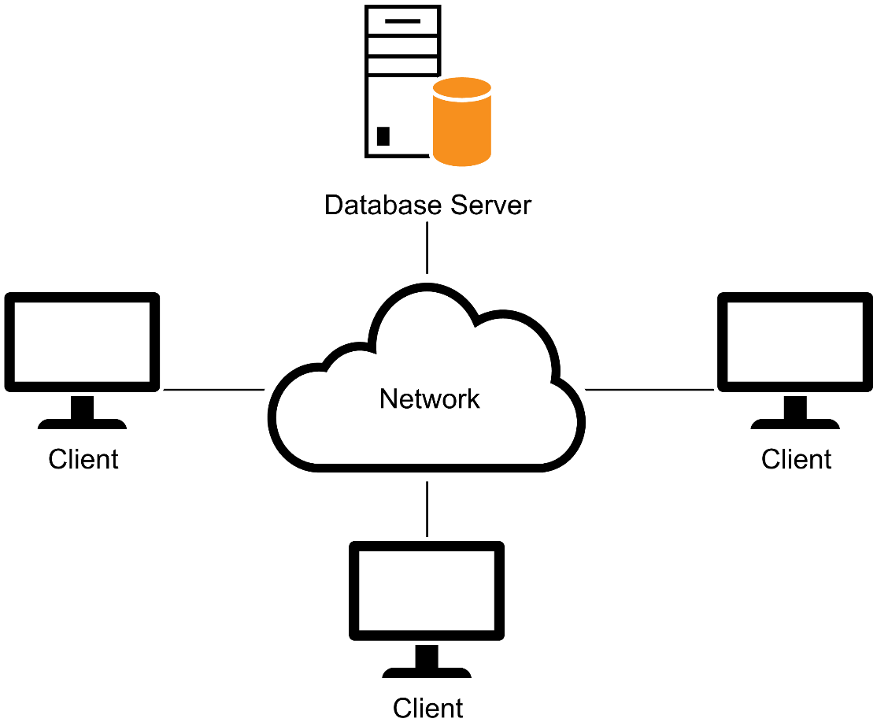
A simple client/server system

Slide 5
The three hardware components of a client/server system

Slide 6
Client/server system implementations

Slide 7
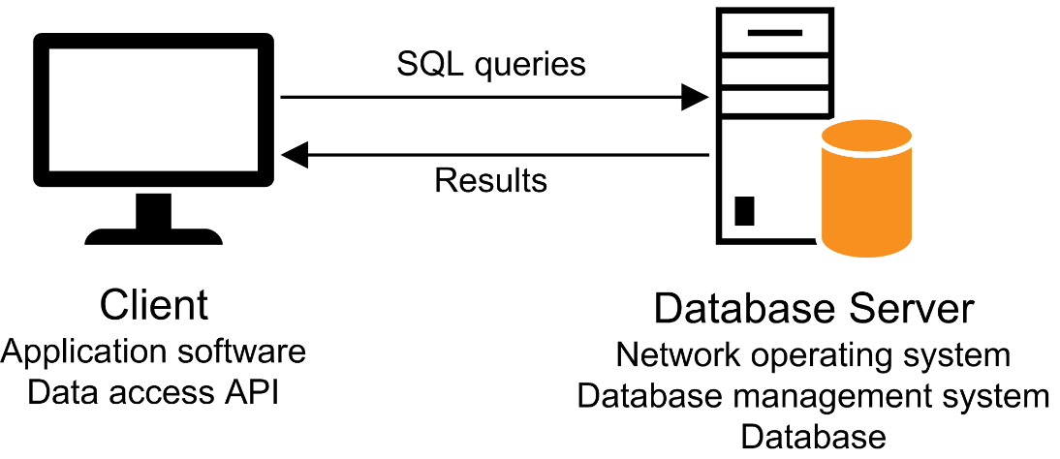
Client software, server software, and the SQL interface

Slide 8
Server software

Slide 9
Client software

Slide 10
The SQL interface

Slide 11
Client/server versus file-handling systems

Slide 12
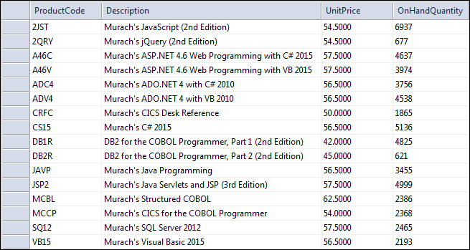
The Products table in the MMABooks database

Slide 13
How a table is organized

Slide 14
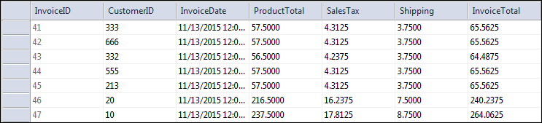
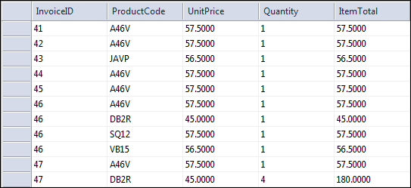
Two related tables: Invoices and InvoiceLineItems

Slide 15
How the tables in a database are related

Slide 16
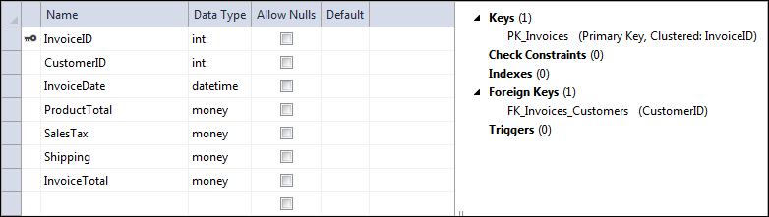
The Server Explorer design view window for the Invoices table

Slide 17
Common SQL Server data types

Slide 18
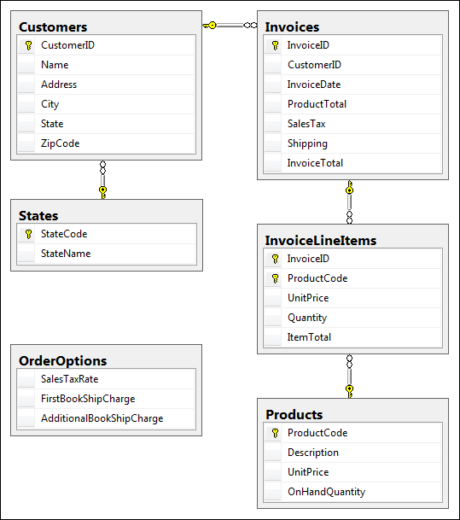
The tables that make up the MMABooks database

Slide 19
Simplified syntax of the Select statement

Slide 20
A Select statement that retrieves and sorts selected columns and rows from the Customers table

Slide 21
How to query a single table

Slide 22
The syntax of the Select statement for joining two tables

Slide 23
A Select statement that joins data from the InvoiceLineItems and Products tables

Slide 24
How to join data from two or more tables

Slide 25
The syntax of the Insert statement for adding a single row

Slide 26
The syntax of the Update statement

Slide 27
The syntax of the Delete statement

Slide 28
.NET data provider core objects

Slide 29
Data providers included with the .NET Framework

Slide 30
Class names for the data providers

Slide 31
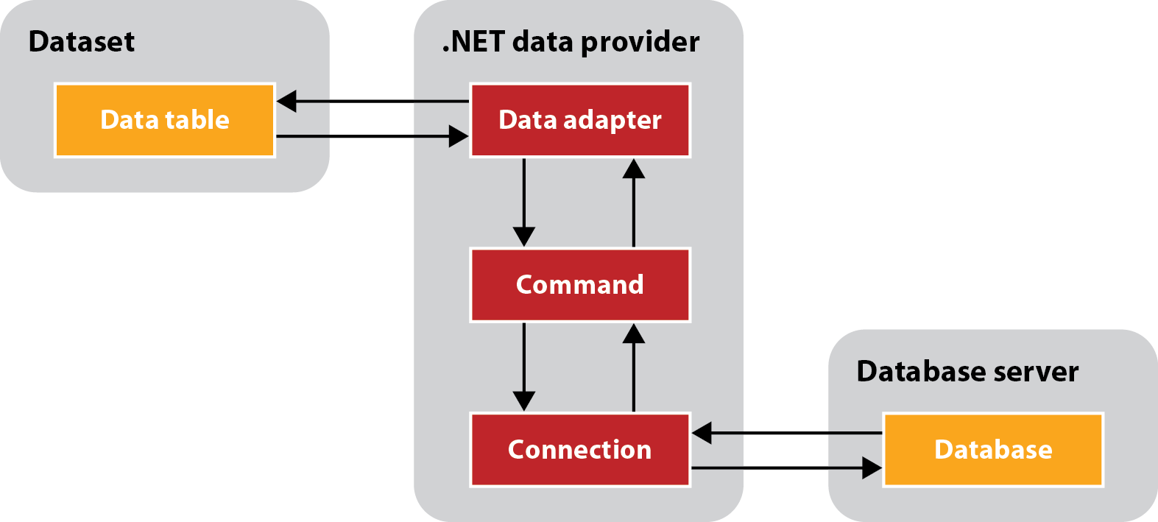
Basic ADO.NET components

Slide 32
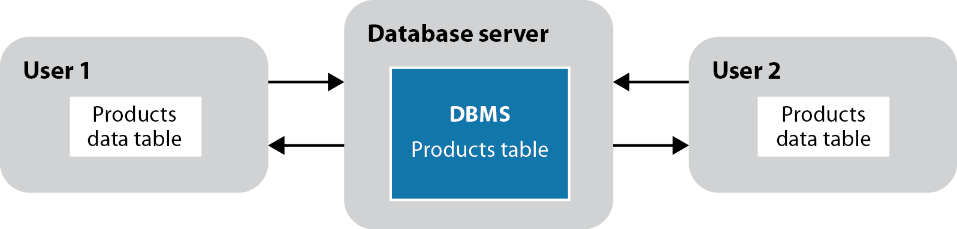
Two users who are working with copies of the same data

Slide 33
Concurrency concepts

Slide 34
Concurrency concepts (cont.)

Slide 35
How to avoid concurrency errors

Slide 36
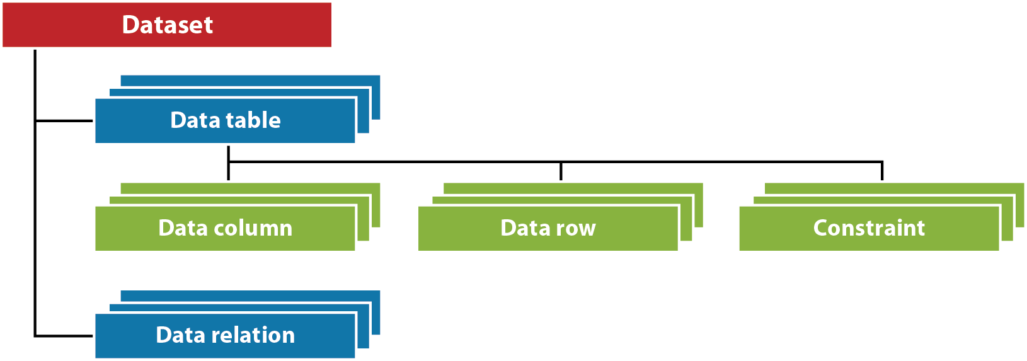
The basic dataset object hierarchy

Slide 37
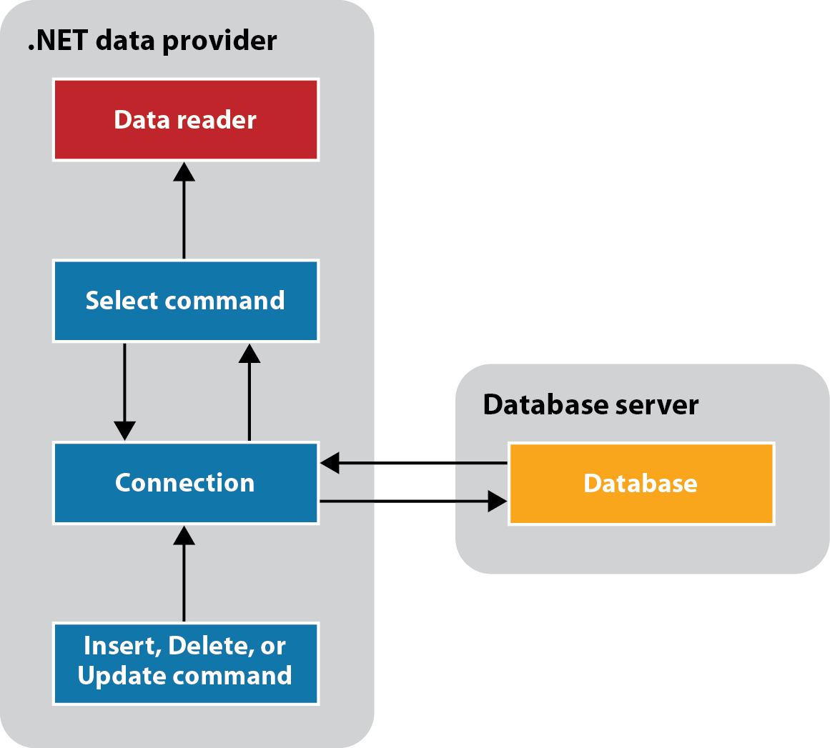
ADO.NET components for accessing a database directly

Slide 38
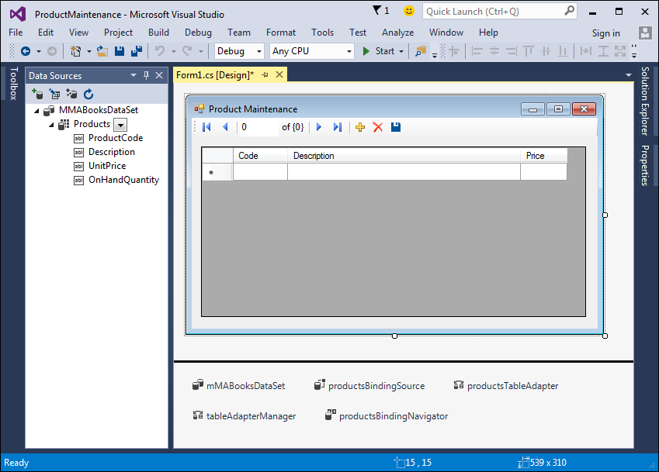
ADO.NET objects created using the Data Sources window

Slide 39
ADO.NET objects created using code

